Slide 1
Product, Services, and Brands: Building Customer Value

Slide 2

What Is a Product?
Products, Services, and Experiences
Product is anything that can be offered in a market for attention, acquisition, use, or consumption that might satisfy a need or want.
Service is any activity or benefit that one party can offer that are intangible and does not result in the ownership of anything.
https://www.youtube.com/watch?v=nbIvO6PT6BA

Slide 3
Experience
Experiences represent what buying the product or service will do for the customer.
https://www.youtube.com/watch?v=gB918UhpQTI
https://www.youtube.com/watch?v=8cUL_EkO7mU

Slide 4
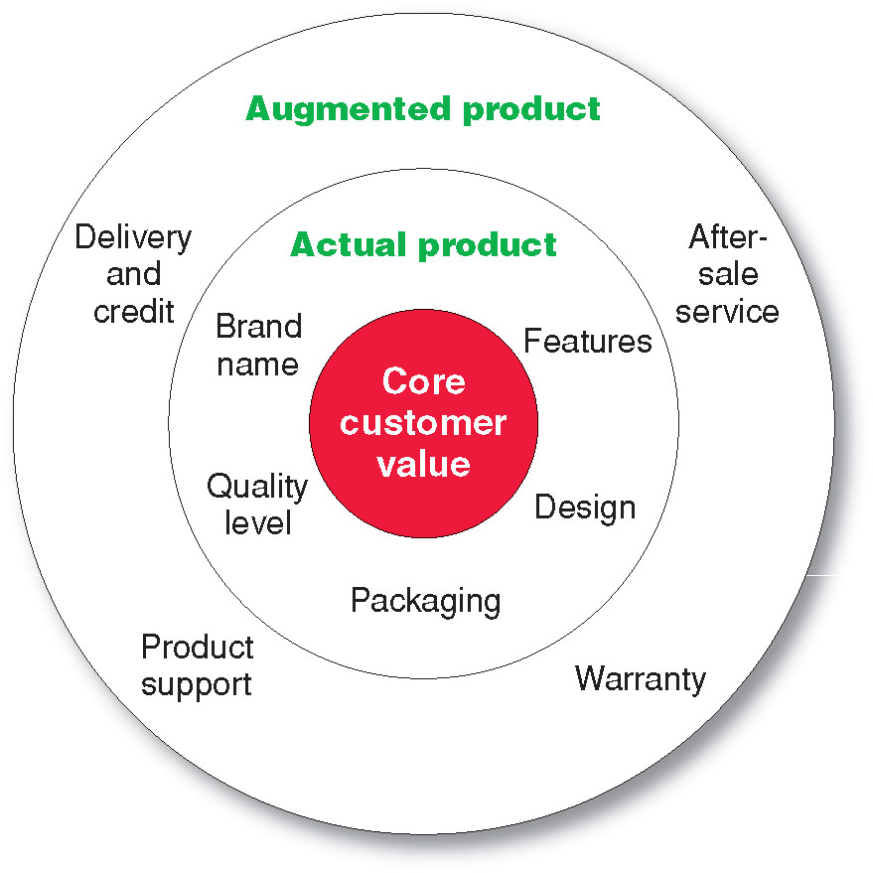
What Is a Product?
Levels of Product and Services

Slide 5
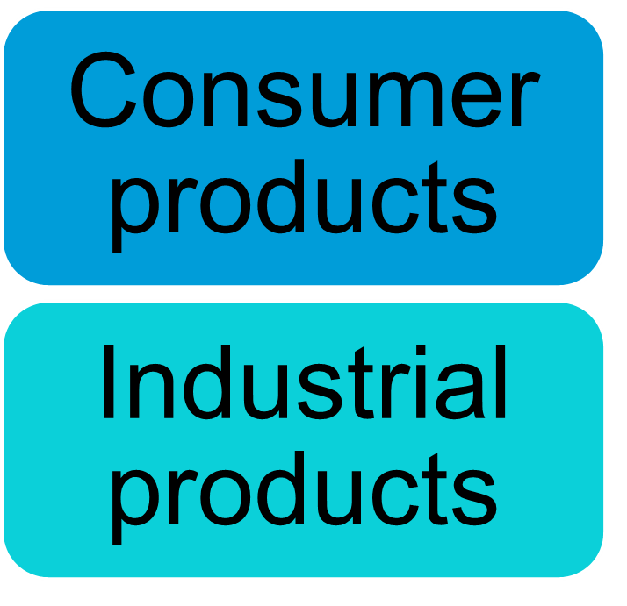

What Is a Product?
Product and Service Classifications

Slide 6
What Is a Product?
Product and Service Classifications
Consumer products are products and services for personal consumption
Classified by how consumers buy them
  Convenience products
  Shopping products
  Specialty products
  Unsought products

Slide 7
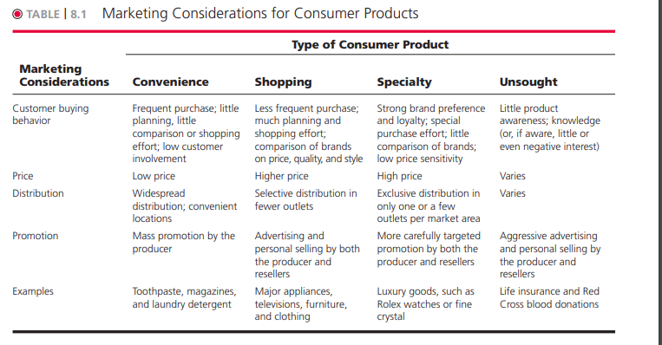

Slide 8
What Is a Product?
Product and Service Classifications
Convenience products are consumer products and services that the customer usually buys frequently, immediately, and with a minimum comparison and buying effort
Newspapers
Candy
Fast food

Slide 9
What Is a Product?
Product and Service Classifications
Shopping products are consumer products and services that the customer compares carefully on suitability, quality, price, and style
Furniture
Cars
Appliances

Slide 10
What Is a Product?
Product and Service Classifications
Specialty products are consumer products and services with unique characteristics or brand identification for which a significant group of buyers is willing to make a special purchase effort
Medical services
Designer clothes
High-end & luxury cars etc.

Slide 11
What Is a Product?
Product and Service Classifications
Unsought products are consumer products that the consumer does not know about or knows about but does not normally think of buying
Life insurance
Funeral services
Blood donations

Slide 12
What Is a Product?
Product and Service Classifications
Industrial products are products purchased for further processing or for use in conducting a business
Classified by the purpose for which the product is purchased
  Materials and parts
  Capital
  Raw materials

Slide 13
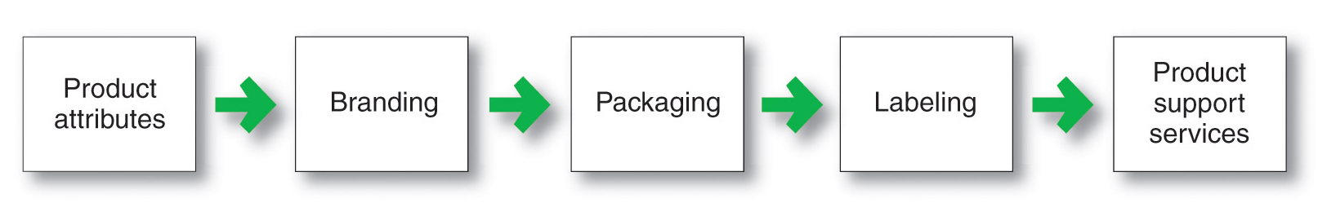
Product and Service Decisions
Individual Product and Service Decisions

Slide 14
Product and Service Decisions
Individual Product and Service Decisions
Product attributes Describe the main product features, major benefits received by those who use the product
Quality
Features
Style and design

Slide 15
Product and Service Decisions
Individual Product and Service Decisions
Product quality includes;
Performance quality
Conformance quality

Slide 16
Product and Service Decisions
Individual Product and Service Decisions
Product features are a competitive tool for differentiating a product from competitors’ products
Product features are assessed based on the value to the customer versus the cost to the company

Slide 17
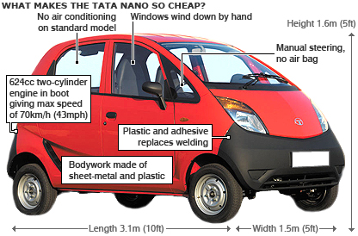

Product and Service Decisions
Individual Product and Service Decisions
Style describes the appearance of the product
Design contributes to a product’s usefulness as well as to its looks

Slide 18
Product and Service Decisions
Individual Product and Service Decisions
Brand is the name, term, sign, or design or a combination of these that identifies the maker or seller of a product or service

Slide 19
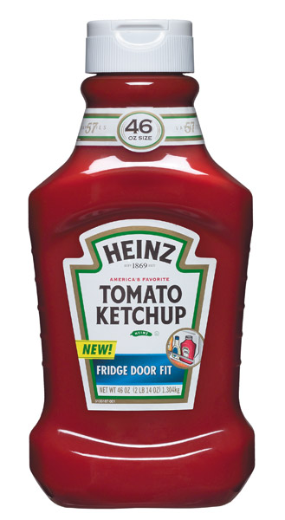
Product and Service Decisions
Individual Product and Service Decisions
Packaging involves designing and producing the container or wrapper for a product
Labels identify the product or brand, describe attributes, and provide promotion
https://www.youtube.com/watch?v=keOaQm6RpBg

Slide 20

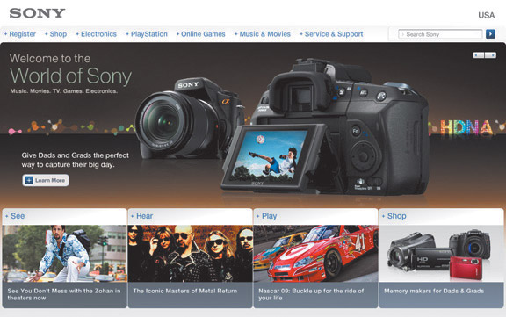
Product and Service Decisions
Product Mix Decisions
Product mix consists of all the products and items that a particular seller offers for sale

Slide 21
Product and Service Decisions
Product Line Decisions
Product line is a group of products that are closely related because they function in a similar manner, are sold to the same customer groups, are marketed through the same types of outlets, or fall within given price ranges

Slide 22
Product and Service Decisions
Product Line Decisions
Product line length is the number of items in the product line

Slide 23
Procter &
Gamble
Body Wash
& Soap
Antiperspirants
&
Deodorants
Hair Care
Ivory
Olay
Old Spice
Secret
Pantene
Herbal Essences
Camay
Noxzema
Infusium
Head &
Shoulders
Zest
Safeguard

Slide 24
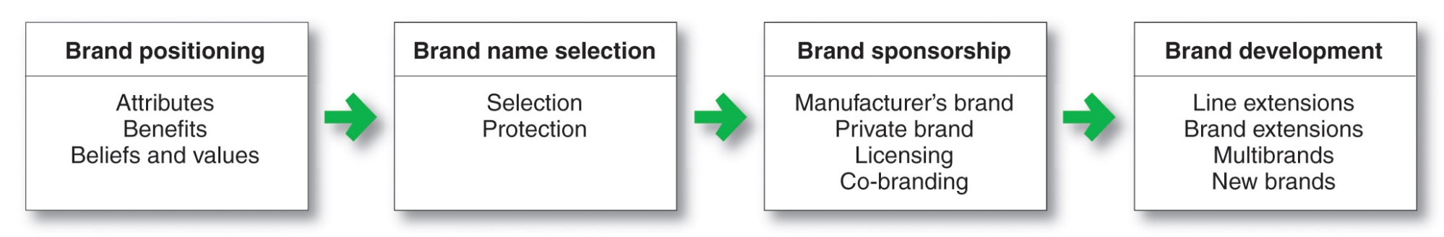
Branding Strategy: Building Strong Brands
Brand represents the consumer’s perceptions and feelings about a product and its performance. It is the company’s promise to deliver a specific set of features, benefits, services, and experiences consistently to the buyers

Slide 25
Services Marketing
Types of Service Industries
Government
Private not-for-profit organizations
Business services

Slide 26
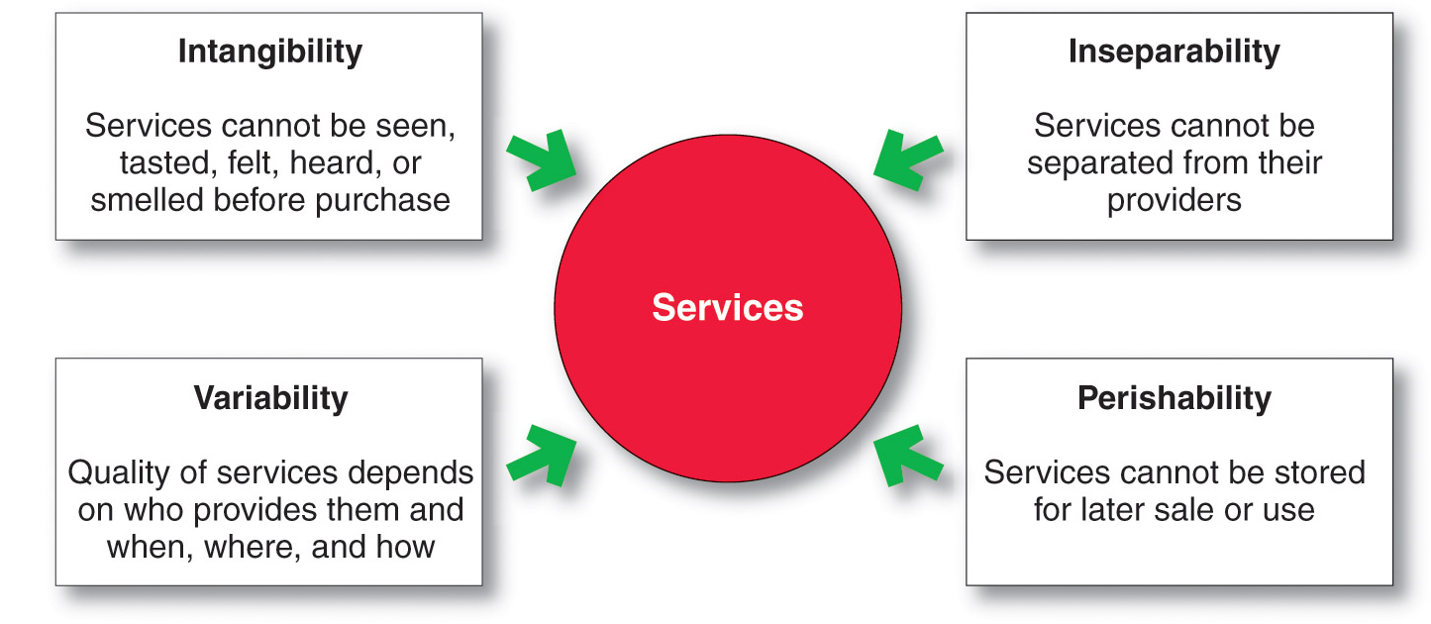
Services Marketing
Nature and Characteristics of a Service

Slide 27

Services Marketing
Marketing Strategies for Service Firms
In addition to traditional marketing strategies, service firms often require additional strategies
Service-profit chain
Internal marketing
Interactive marketing

Slide 28

Services Marketing
Marketing Strategies for Service Firms
Managing service quality provides a competitive advantage by delivering consistently higher quality than its competitors
Service quality always varies depending on interactions between employees and customers

Slide 29
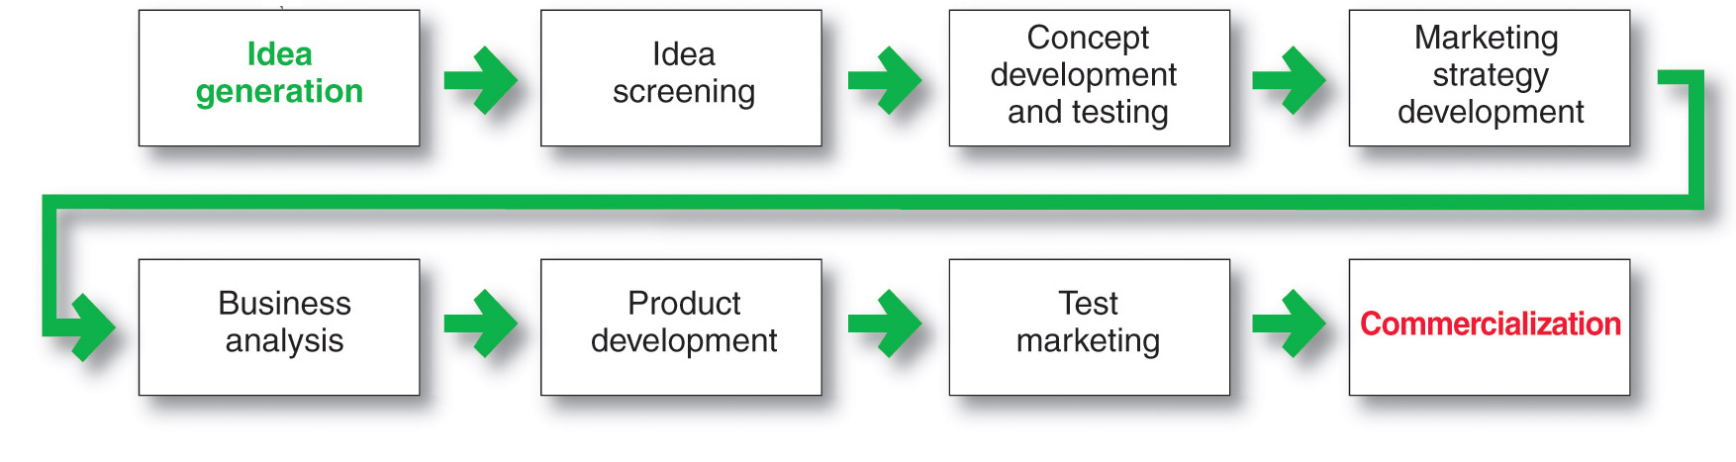
New-Product Development Process
Major Stages in New-Product Development
https://www.youtube.com/shorts/6kk6Imj_CsQ
https://www.youtube.com/watch?v=JbZW_oCUlsg

